Slide 1
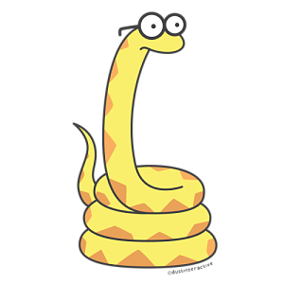
Book Constrictor
Yuan Yang Matthew Lee

Slide 2
Book Reading and Data Science
Gives you an in depth summary of books before you have to read them
Compares various books against each other
Analyzes and graphs trends (Sentence length, word count and character appearance)
Summarize information into data
We chose Tom Sawyer to start with

Slide 3
Preparation
Scratch codes from “Computational and Inferential Thinking” website:
Parse through HTML
Counting words and sentences
Build cumulative graphs
Further work by us:
Build data frame to summarize the information of books
Build graphs to directly compare different books
Keyword searching in sentences to explore books’ theme and plots

Slide 4
Packages Needed
Uril.librequest
Numpy
Pandas
Matplotlib

Slide 5
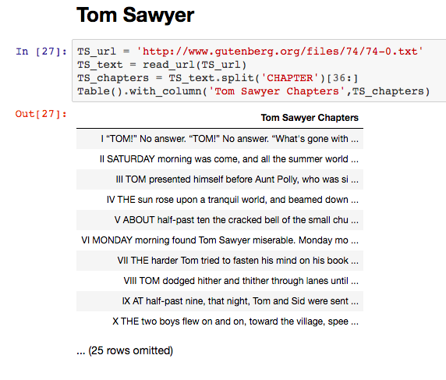

Slide 6
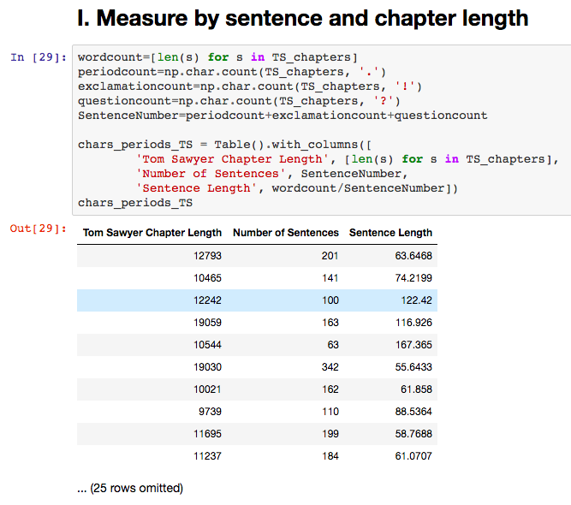

Slide 7
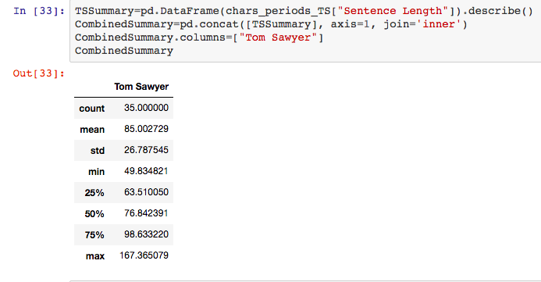

Slide 8
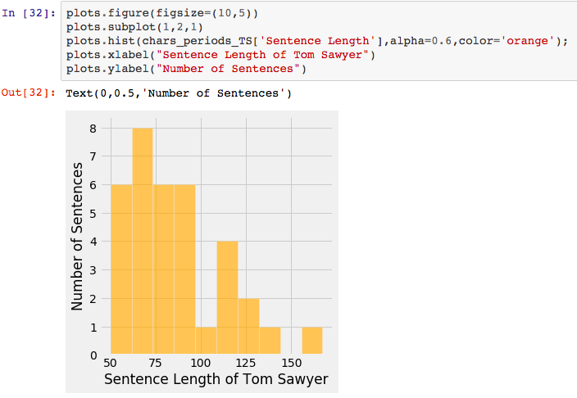

Slide 9
To be continued...

